Slide 1


Quakes: A Predictive Analysis on Earthquakes near Mt. Fuji
Julia Cuellar
DSC 630

Slide 2
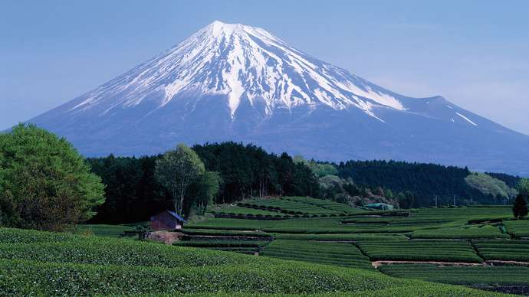
Abstract
Figure 1 Japan: Fuji, Mount
Mt. Fuji is the highest mountain in Japan and an active volcano. There are three clear planes of seismic activity near Mt. Fuji. The triple junction of tectonic activity is the Amurian plate (associated with the Eurasian tectonic plate), the Okhotsk plate (associated with the North American plate), and the Filipino plate along with the Japan Trench. The Hōei eruption of 1707 has an assumption of a correlated relationship between earthquakes and volcanic eruptions. A predictive analysis will be performed to determine what factors from seismic activity could cause a potential catastrophic natural disaster (i.e. volcanic eruption) to chance in the country of Japan.

Slide 3
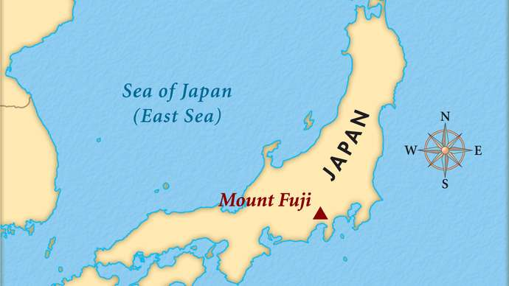
Background
Figure 2 Mount Fuji
“Mount Fuji, Japanese Fuji-san, also spelled Fujisan, also called Fujiyama or Fuji no Yama,…” is the highest mountain in Japan in which it rises to 12,388 feet (or 3,776 meters). Mt. Fuji (for short) is located near the Pacific Ocean coast in the Yamanashi and Shizuoka ken prefectures of central Honshu, approximately 60 miles (or 100 kilometers) west of the Tokyo-Yokohama metropolitan area. Mt. Fuji is not just a mountain but an active volcano. Mt. Fuji has a graceful conical form, and the volcano was formed in 286 BCE from an earthquake.

Slide 4
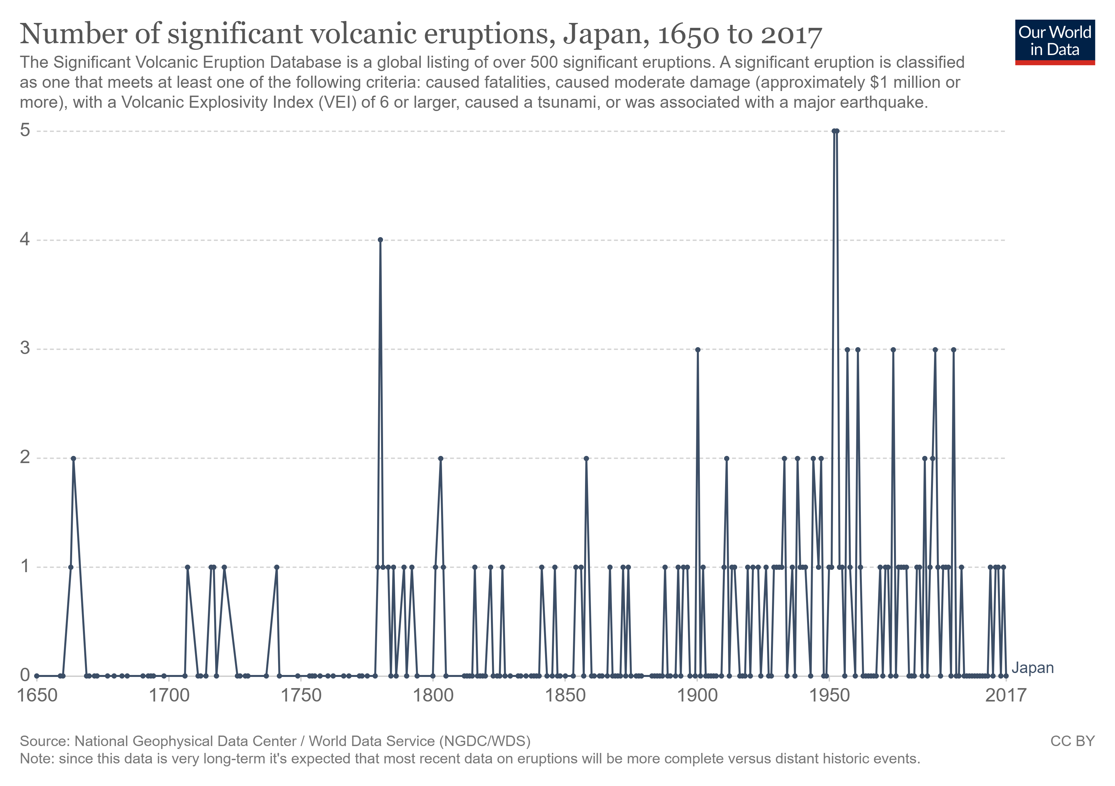
Business Understanding
Figure 3 Number of significant volcanic eruptions, Japan, 1650 to 2017
The Hōei eruption of 1707 was proceeded by an 8.6 magnitude (based off the Richter scale) earthquake and a tsunami followed right after the volcanic eruption. This brings us to a dire question: can earthquakes trigger volcanic eruptions? Based on the example of Mt Fuji’s 1707 volcanic eruption (AKA Hōei), we can assume the correlation between earthquakes and volcanic eruptions is possibly linked to one another.

Slide 5
Data Understanding - Quakes
A data frame with 1,000 observations on 5 variables.
lat (Latitude of event)
long (Longitude)
depth (Depth in km)
mag (Richter Magnitude)
stations (Number of stations reporting)
The dataset give the locations of 1,000 seismic events of MB (magnitude based) > 4.0.
(Head)
lat long depth mag stations
0 -20.42 181.62 562 4.8 41
1 -20.62 181.03 650 4.2 15
2 -26.00 184.10 42 5.4 43
3 -17.97 181.66 626 4.1 19
4 -20.42 181.96 649 4.0 11

Slide 6
Data Preparation
Due to the fact that this data set is supplied from a R repository, there is no Nulls, NaN’s, or missing values, thus, no data manipulation will transpire upon the dataset.

Slide 7
Business Questions
How does the depth from an earthquake relate to volcanic activity?
How does the magnitude from an earthquake relate to volcanic activity?
Can the latitude and longitude be used to predict seismic activity which in turn could predict volcanic activity?
Notes:
Meaning, how deep from the earth’s surface to the tectonic plate that reaches the volcanic environment. Meaning, based off the Richter scale. Meaning, coordinates near or around tectonic plates.

Slide 8
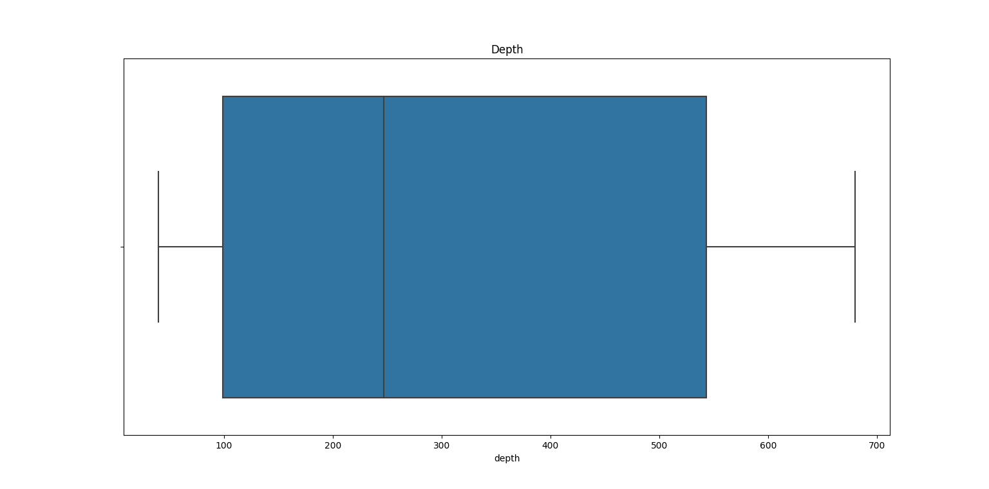
Depth of an Earthquake
Boxplot of depth of an earthquake
A box plot was made for the depth variable based off the quakes data set; there are no outliers.

Slide 9
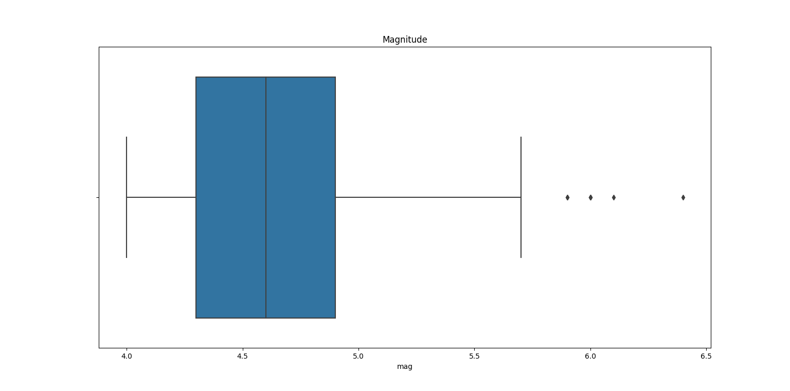
Magnitude of an Earthquake
Boxplot of magnitude of an earthquake
A box plot was made for the magnitude variable based off the quakes data set; there are outliers which will still be included (i.e., not removed from the original dataset).

Slide 10
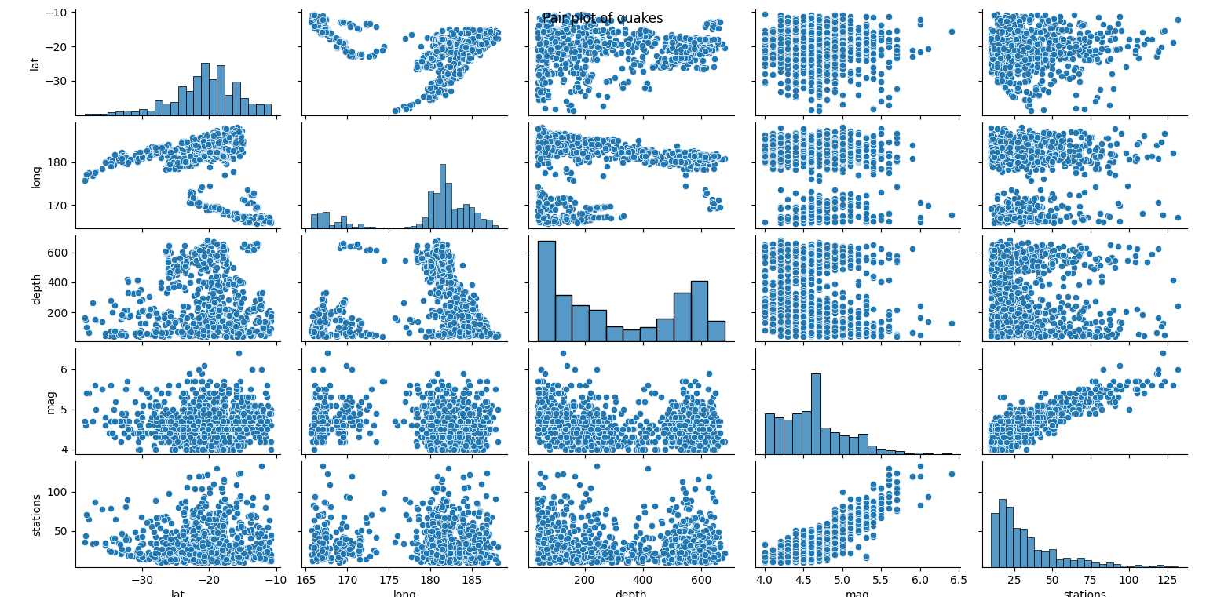
Latitude & Longitude of an Earthquake
Pair plot of latitude & longitude of an earthquake
A pair plot was made for the variables of latitude and longitude based off the quakes data set; there are no outliers.

Slide 11
Assumptions
Due to Mt. Fuji having two magma chambers, the shallow reaching 8 km while the deeper reaches 20 km, the depth of an earthquake as determined by USGS will fall more into a deeper earthquake which would result in a possible volcanic eruption.
With magnitudes not reaching its highest since 1707, based off the data for seismic activity from the year of 1964 and up, earthquakes in the mid-Richter scale will not contribute to volcanic eruptions.
The latitude and longitude for Mt. Fuji is about 35° N and 138° E, with coordinates exact or close to the proximity to Mt. Fuji as well as near the tectonic activity that is underneath the active volcano, could potentially predict where an earthquake may strike resulting in a possible volcanic eruption.
Upon performing exploratory data analysis (or EDA) with boxplots and a pair plot when considering the business questions, depth from an earthquake might be the only factor rendering to volcanic activity.

Slide 12
Modeling/Methods
To perform this predictive analysis of whether seismic activity relates to volcanic eruptions, clustering models will be built on the depth and magnitude of an earthquake while a multiple, linear regression model will be built on latitude and longitude.

Slide 13
Deployment/Results
After building clustering models for depth and magnitude of an earthquake as well as a multiple, linear regression model for the latitude and longitude, a performance check on the models will be executed to deliberate whether seismic activity contributes to volcanic eruptions.

Slide 14
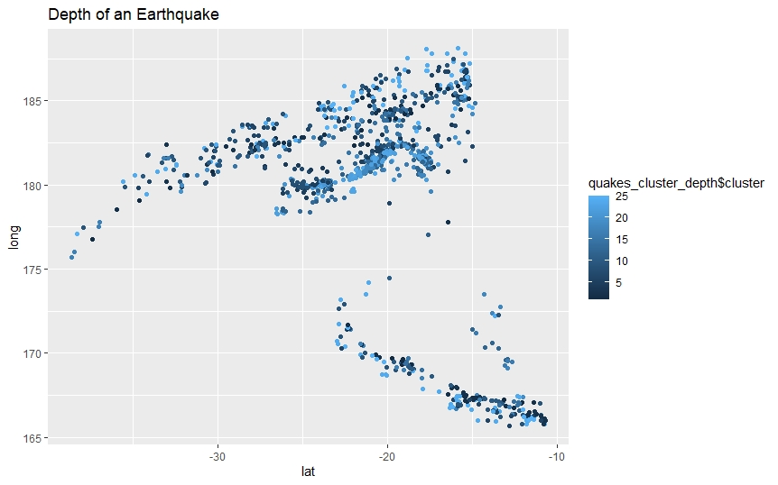
Deployment/Results cont.
Cluster diagram of Depth of an Earthquake
In the clustering model built for depth of an earthquake, it tends to flock to about 311 km to where the final resultant based off the question: does the depth from an earthquake relate to volcanic activity, can be drawn to a positive correlation between the two. Ergo, after the performance check of the clustering model created from a depth of an earthquake, the model’s performance was nearly 100% (99.9%), therefore, a conclusion of does the depth from an earthquake relate to volcanic activity is that there is a correlation with the two and the factor of depth from an earthquake extends to volcanic activity.

Slide 15
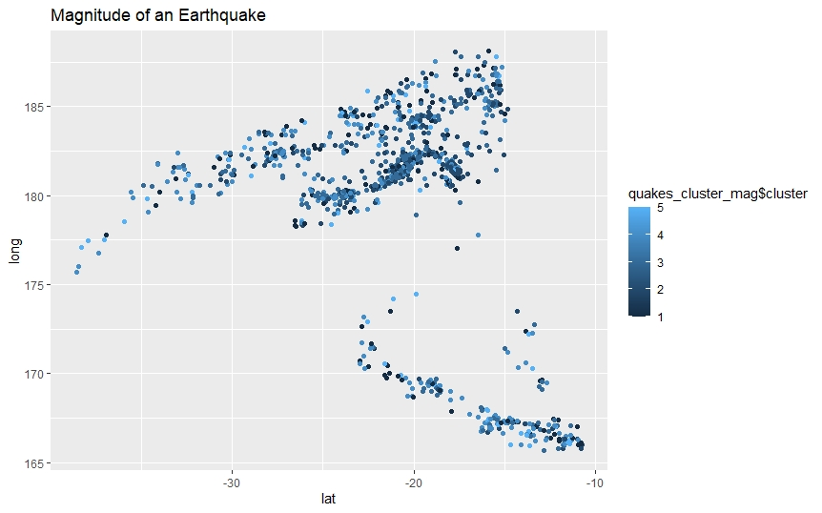
Deployment/Results cont.
Cluster diagram of Magnitude of an Earthquake
In the clustering model built for magnitude of an earthquake, it tends to flock to about 4.6 on the Richter scale to where the final resultant based off the question: does the magnitude from an earthquake relate to volcanic activity, can be drawn to a no correlation between the two. However, after the performance check of the clustering model created from a magnitude of an earthquake, the model’s performance was 93.5%, therefore, a conclusion of does the magnitude from an earthquake relate to volcanic activity is that there is a correlation with the two and the factor of magnitude from an earthquake extends to volcanic activity, yet minimally so.

Slide 16
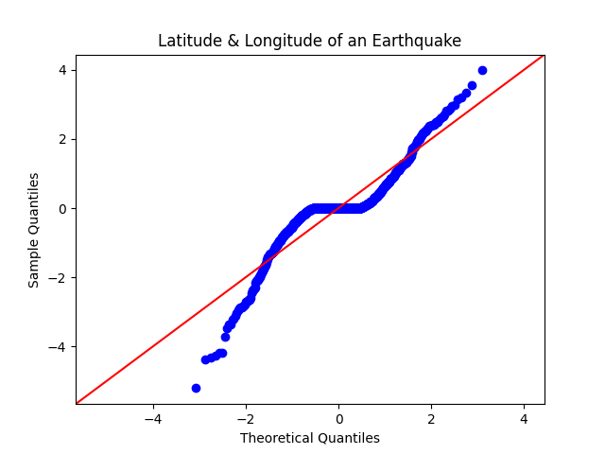
Deployment/Results cont.
Regression plot of Latitude & longitude of an earthquake
In the multiple, linear regression model built for latitude and longitude of an earthquake, it tends to flock to about the coordinates of Mt. Fuji to where the final resultant based off the question: can the latitude and longitude be used to predict seismic activity which in turn could predict volcanic activity, can be drawn to a correlation between the two. Ergo, after the performance check of the multiple, linear regression model created from the latitude and longitude of an earthquake, the model’s performance was about 78.5%, therefore, a conclusion of does the latitude and longitude from an earthquake relate to volcanic activity is that there is a correlation with the two and the factor of latitude and longitude from an earthquake extends to volcanic activity.

Slide 17
Summary & Conclusions
Since the quakes dataset is structurally formatted in a way where there is not much data preparation or wrangling that needs to be done, the more legwork was building the models based off the business questions proposed to the business problem which is: does factors of seismic activity contribute to volcanic eruptions? Following the CRISP-DM process, after the models have been built, a performance check of whether the models are up to par for answering the business problem was administered.

Slide 18
Summary & Conclusions cont.
Based off the clustering models built on the depth & magnitude of an earthquake and a multiple, linear regression model built on latitude & longitude, the performance of those models indicated that depth, magnitude, latitude, and longitude were all factors from an earthquake that render to volcanic activity. However, upon further inspection of the dataset, depth is primarily the only factor from an earthquake that extends to volcanic activity.

Slide 19
Summary & Conclusions cont.
Lastly, conclusions from the results can be drawn but the only drawback to considering that seismic activity has a correlation with volcanic eruptions is due to the fact that the quakes data set has only data from 1964 and up, no data before that year. Thus, the final deduction from the quakes data set is that depth from an earthquake is the only assisting factor to volcanic activity, hence, when observing the correlation between seismic activity and volcanic activity, the depth from an earthquake is the number one contributing factor that should be considered when predicting factors from a seismic activity that could cause a potential catastrophic natural disaster (i.e. volcanic eruption) to chance in the country of Japan.

Slide 20
References
Determining the Depth of an Earthquake. (n.d.). Retrieved from Determining the Depth of an Earthquake (usgs.gov)
International Registry of Seismograph Stations. (n.d.). Retrieved from International Registry of Seismograph Stations (isc.ac.uk)
Japan. (n.d.). Retrieved from Japan - Our World in Data
Locations of Earthquakes off Fuji. (n.d.). Retrieved from R: Locations of Earthquakes off Fiji (vincentarelbundock.github.io)
Mount Fuji. (2021, February 11). Retrieved from Mount Fuji | Facts, Height, Location, & Eruptions | Britannica
Mount Fuji. (n.d.). Retrieved from Mount Fuji | National Geographic Society
Mt. Fuji: The Earthquake that caused a Volcanic Eruption. (n.d.). Retrieved from Mt Fuji: The Earthquake that caused a Volcanic Eruption | Volcano World | Oregon State University

